Slide 1
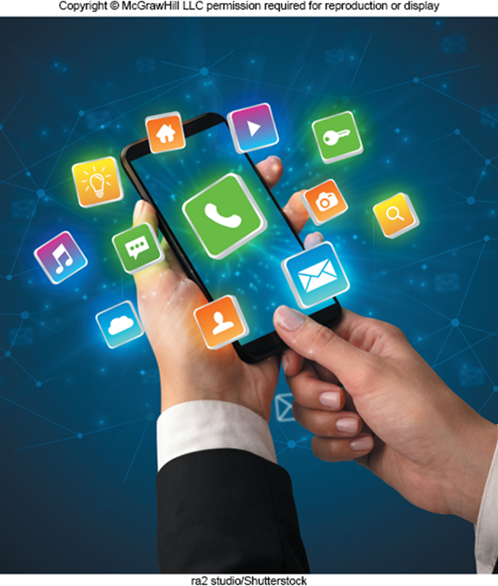
Chapter 1
Information Technology, the Internet, and You
张元平
13594006339
Notes:
This chapter introduces you to skills and concepts you need to be prepared for the ever-changing digital world.

Slide 2
Learning Objectives
Explain the parts of an information system: people, procedures, software, hardware, data, and the Internet.
Distinguish between system software and application software.
Differentiate between the three kinds of system software programs.
Define and compare general-purpose, specialized, and mobile applications.
Identify the four types of computers and the five types of personal computers.
Describe the different types of computer hardware, including the system unit, input, output, storage, and communication devices.
Define data and describe document, worksheet, database, and presentation files.
Explain computer connectivity, the wireless revolution, the Internet, cloud computing, and IoT.
Notes:
Review the Learning Objectives with students to help them understand what they need to get from the chapter.

Slide 3
Introduction
Purpose of this book.
Help users become highly efficient and effective computer users.
Teach how to use:
Apps and application software.
Computer hardware.
Mobile devices.
Smartphones.
Tablets.
Laptops.
The Internet.
Illustrate the impact of technology on privacy and the environment and the role of personal and organizational ethics.
Notes:
Chapter 1 is an overview of all of the content within all of the chapters.
The goal of this book is to help you become an efficient and effective computer user.

Slide 4
Parts of an Information System
People.
Procedures.
Software.
Hardware.
Data.
Internet.
Notes:
An information system (Key Term) is a combination of people, procedures (key term), software (key term), hardware (key term), data (key term), and the Internet (key term).
Some students may think of a system as pertaining to just the hardware
Remind them that a personal computer is part of an information system as well as people
Almost all of today’s computer systems add an additional part, communication/the Internet.
To be a competent end user (Key Term), one must understand the essentials of IT
Note that IT stands for information technology (Key Term)
All of these parts will be discussed in the following slides – beginning with the most essential part: people

Slide 5

People
Most important part of any system.
Ways this text helps you become a more efficient and effective computer users.
Making IT Work for You.
Tips.
Privacy.
Community.
Ethics.
Careers in IT.
Goodluz/Shutterstock
Notes:
People (Key Term) or End Users are the most important part of an information system but easy to overlook
Our lives are touched everyday by computers- many time the contact is direct and obvious, such as creating documents using a word processing program or when connecting to the Internet. Other times, it isn’t as obvious and is much more indirect as shown in a couple of the pictures
Have students give examples of how they use computer applications throughout the day
Some examples are:
Free Antivirus Programs
Online Office Suites
Gaming
Cloud Storage
The Mobile Office

Slide 6
Software
Software/Programs.
Tell the computer how to process data into the form you want.
Two major kinds of software:
System Software: Software used by computers.
Application Software: Software you use.
Notes:
Software (Key Term) is another name for programs (Key Term) – in most cases these terms are interchangeable
Programs are instructions that tell the computer how to process data (Key Term) into the form you want
Two major kinds of software: System and Application
Emphasize differences between application and systems software
System software (Key Term) – computer uses
Application software (key term) – software you use

Slide 7
System Software
Software that enables application software to interact with the computer hardware.
Background software helps manage resources.
Collection of system programs including:
Operating Systems(OS).
Utilities.
Notes:
System
A collection of programs – Operating System and Utilities

Slide 8
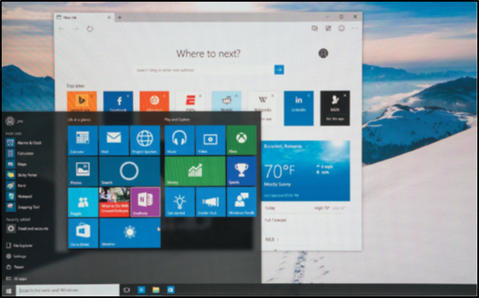
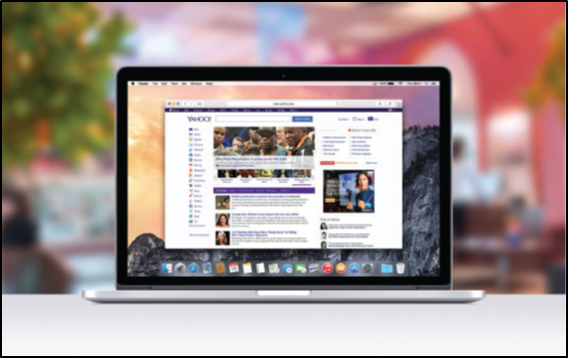
Operating System
Coordinates computer resources.
Provides the user interface.
Runs applications.
Types of Operating Systems:
Embedded operating system.
Used by Smartphones, tablets, and other mobile devices.
Also known as real-time operating systems (R T O S).
Standalone operating system.
Used by desktops.
Networking operating systems. （NOS）
Used to run networks.
Microsoft Corportation; Applie, Inc.
Notes:
Operating System (key term)
Coordinates computer resources
Provides an interface between users and the computer
Runs applications
Two best known Operating systems are:
Windows 10
Apple’s Mac OS

Slide 9
Utilities
Perform specific tasks related to managing computer resources.
Example: Antivirus Program.
Protects from viruses.
Can damage your software or hardware.
Comprise the security and privacy of personal data.
Notes:
Utilities (key term)
Performs tasks related to managing computer resources
Most essential utility program is antivirus program to protect your system from viruses (Key term) or malicious programs that can damage your software or hardware as well as compromise the security and privacy or your personal data
See how you can install a free antivirus program on your computer – Making IT Work for You: Free Antivirus Program on page 9

Slide 10
Application Software
End-user software.
Types of application software include:
General-Purpose applications.
Word Processor. Flyer
Spreadsheets.
Database Management Systems. （Access）
Presentation software. POST
Specialized applications
Web Authoring.
Apps.
Social media apps. (H5)
Notes:
“End-user” (Key Term) software – these are the types of programs you have to know to be considered computer competent
Three types of application software
General-Purpose applications (key term) - general purpose or “off-the-shelf” programs, such as Microsoft Word, Excel, Access and PowerPoint
Specialized application (key term)– narrow focus on specific disciplines and occupations, such as graphics and Web authoring
Mobile Apps (key term)– or apps (key term)– designed for mobile devices (key term) or tablets for social networking, games, music, and video

Slide 11
Hardware – Types of Computers
Supercomputers.
Most powerful computers.
Mainframe computers.
Process large amounts of data.
Midrange computers.
Servers.
Personal computers.
P Cs.
Five types of P Cs.
Notes:
There are four types of computers
Supercomputers (key term) – the most powerful; special high-capacity computers used in very large corporations
Mainframe computers (key term) – are capable of great processing speed and data storage; occupy specially wired, air-conditioned rooms; insurance companies use to process information about millions of policyholders
Midrange computers (key term) - known as servers (key term), are computers with processing capabilities less powerful than a mainframe computer yet more powerful than a personal computer. Today they are used to support or serve end users for specific needs such a retrieving data from a database or supplying access to application software.
Personal computers or pcs (key term) – least powerful but most widely used and fastest-growing type of computers. There are five (5) types of pcs.

Slide 12
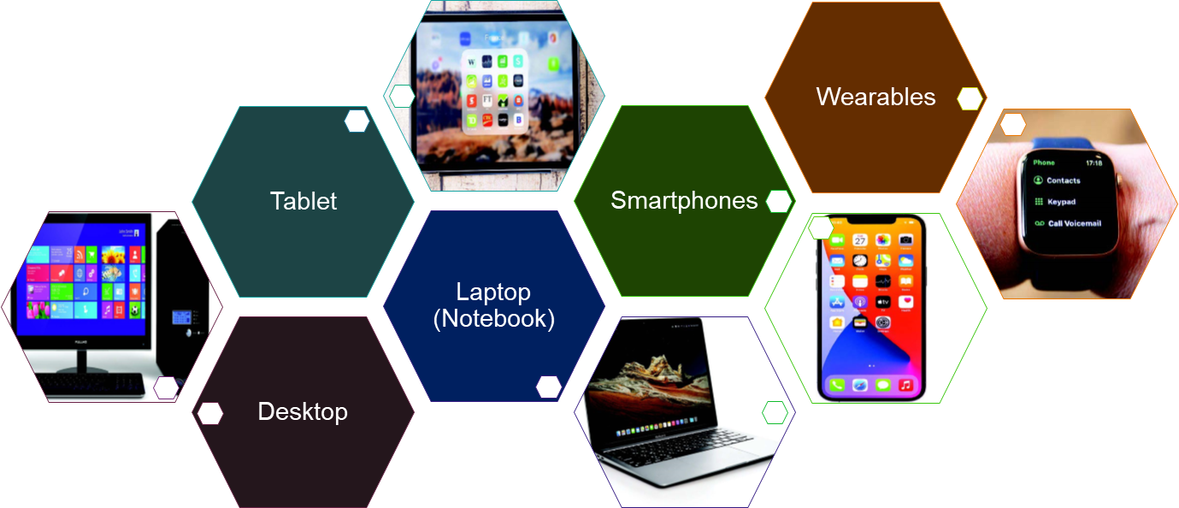
Personal Computer Types
Access the text alternative for slide images.
Scanrail1/Shutterstock; 4X-image/iiStock/Getty Images; Colin Hui/Shutterstock; junior_cinematic/Shutterstock; Bai-Bua’s Dad/Shutterstock
Notes:
Desktop (key term) – small enough to fit on top of a desk yet too big to carry around
Laptop (key term) – or notebook computers (key term) are portable, lightweight and bit into most briefcases
Tablet (key term) – iPad for example, are smaller, lighter and less powerful than laptops and use a virtual keyboard.
Smartphones (key term) is the most common handheld
Wearables – such as the Apple Watch

Slide 13
Personal Computer Hardware
Four basic categories of equipment.
System Unit.
Input/Output. （BIOS）
Secondary Storage.
Communication.
Notes:
System Unit (key term) is the container that houses most of the electronic components that make up a computer system.
Input/Output – Input devices (key term) translate data and programs from a form humans understand to a form computers can process; Output devices (key term) translate the processed information from the computer into a form that humans can understand
Secondary Storage (key term) – Unlike memory (key term), secondary storage holds data and programs even after the electrical power has been turned off—examples of secondary storage include USB drives, hard drives and optical drives
Communication – one computer communicating with another computer or other computer systems using communication devices (key term) such as a modem (key term)

Slide 14
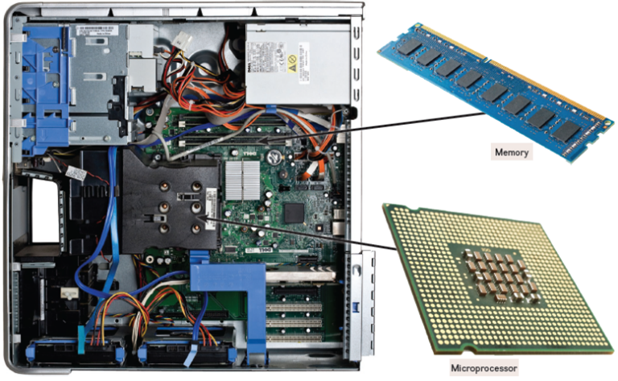
System Unit
Houses most of the electronic components.
Contains two important components.
Microprocessor. （CPU）
Memory.
Holds data currently being processed.
Holds the processed information before it is output.
Temporary storage, contents are lost when power is off.
EML/Shutterstock; (RAM): Simon Belcher/Alamy Stock Photo (Microprocessor); leungchopan/Stock/Getty Images
Notes:
Two important components of the System Unit are the Microprocessor (key term) which controls and manipulates data to produce information and Memory (key term) which is a holding area for data, instructions, and information.
RAM or random-access memory (key term) is one type of memory that holds the program and data that is currently being processed. This is temporary storage because the contents are lost when the power is turned off

Slide 15
Input/Output Devices
Input.
Translate data into computer language.
Keyboard and Mouse.
Output.
Translate computer data into usable information.
Display, also known as the monitor.
Notes:
Input devices translate data and programs that humans can understand into a form that the computer can process.
The most common input devices are the keyboard (key term) and mouse (key term)
Output devices translate the processed information from the computer into a form that humans can understand.
The most common output device is a display (key term) or monitor (key term)

Slide 16
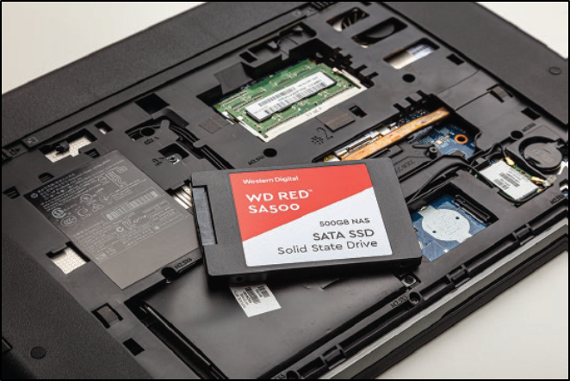
Secondary Storage
Holds data and programs even if power is off.
Hard disk.
Solid-state storage.
No moving parts.
More reliable.
Requires less power.
Optical disc.
Laser technology.
C Ds, D V Ds, Blu-ray.
Bob Dormon/theregister.co.uk
Notes:
Unlike memory, secondary storage holds data and programs even if power is off
Hard disks (key term) are typically used to store programs and data files. They use rigid metallic platters and read/write heads for writing and reading data
Solid-state storage(key term) does not have any moving parts, is more reliable, and requires less power to operate.
Similar to RAM but not volatile
Optical disks (key term) use laser technology and have the greatest capacity.
Examples of optical disks include:
compact discs (CDs) (Key Term)
digital versatile or video discs (DVDs) (Key Term)
Blu-ray (Key Term) discs

Slide 17
Data
Raw, unprocessed facts.
Processed data becomes information.
Digital data is stored electronically in files.
Notes:
Data is raw, unprocessed facts, that can be stored electronically in files.
Processed data becomes information (key term).
Four common types of files include:
Document files (key term) – created by word processors to save documents such as memos, term papers, and letters
Worksheet files (key term) – created by electronic spreadsheets to analyze things like budgets and to predict sales
Database files (key term) – created by database management programs to contain highly structured and organized data
Presentation files (key term) – created by presentation software to save presentation materials

Slide 18
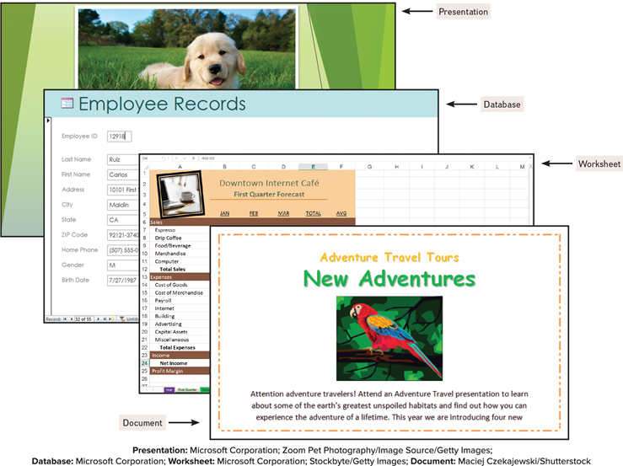
Common Types of Files
Document.
Worksheet.
Database.
Presentation.
O’Leary Text
Notes:
Document - created by word processors to save documents such as memos, term papers, and letters.
Worksheet files - created by electronic spreadsheets to analyze things like budgets and to predicts sales.
Database files - typically created by database management programs. Contain highly structured and organized files.
Presentation Files – created by presentation graphics programs to save presentation materials.

Slide 19
Communication
Communication devices.
Provide the ability for personal computers to communicate.
Modems.
Modify audio, video and other types of data for Internet usage.
Notes:
Communication devices allow personal computers to communicate with each other as near as the next office or as far away as the other side of the world.

Slide 20
Connectivity and the Mobile Internet
Connectivity.
Sharing of information.
Network.
Communications system connecting two or more devices.
Central to the concept of connectivity.
Largest network is the Internet.
Web provides a multimedia interface for Internet resources.
Notes:
Connectivity (key term) is the capability of your personal computer to share information with other computers
Wireless /mobile communication and cloud computing over the past 5 years has been the 2 most dramatic changes in connectivity.
A network (key term) is central to the concept of connectivity
A network is a communication system connecting two or more computers.
Ask students questions about the Internet. Here are some facts:
No one owns the Internet
There is no Internet, Inc.
The Internet is the largest network
The Word Wide Web (key term) (WWW) provides multimedia interface to resources on the Internet
Cloud computing can be used to create and store your work, such as documents, spreadsheets, databases, and presentations
The Wireless Revolution (key term) and cloud computing promise the potential to dramatically affect the entire computer industry and how you interact with computers.

Slide 21
Forces of Technology
Cloud computing.
Computers on the Internet.
Access to more resources.
Wireless technology.
Changing the way we communicate.
Tablets, smartphones, wearable devices.
Internet of Things (IoT).
Continuing development of the Internet.
Allowing all types of devices to communicate.
Notes:
There are 3 things driving the forces of technology:
Cloud computing (key term) – using computing resources from the cloud to complete tasks instead of relying solely on your PC .
Wireless technology (key term) – changes the way we communicate.
The Internet of Things (IoT) (key term) – is the continuing development of the Internet

Slide 22
Careers in I T
Web Developer.
Develops and maintains websites and web resources.
Computer Technician.
Repairs and installs computer components and systems.
Technical Writer.
Prepares instruction manuals, technical reports, and other scientific or technical documents.
Software Engineer.
Analyzes users’ needs and creates application software.
Computer Support Specialist.
Provides technical support to customers and other users.
Network Administrator.
Creates and maintains computer networks.
Notes:
These are just a few of the available careers in IT.

Slide 23
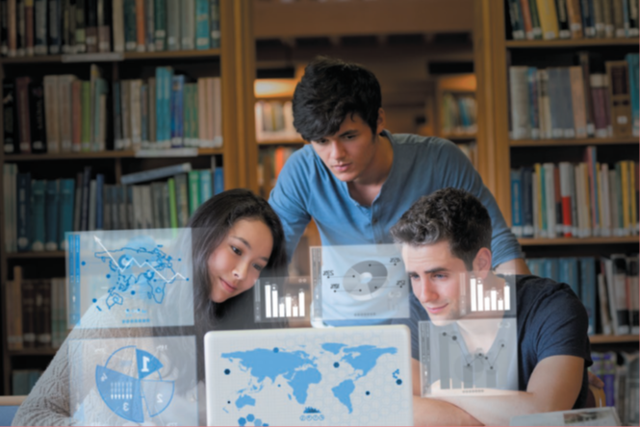
A Look to the Future
Using and Understanding Information Technology.
The Internet and the Web.
Powerful Software.
Powerful Hardware.
Privacy, Security, and Ethics.
Organizations.
Changing Times.
Wavebreakmedia/Shutterstock
Notes:
Internet Web - browse the Web, communicate with others, locate Information, etc.
Powerful Software - create professional looking documents, analyze massive amounts of data, create dynamic multimedia pages, and more.
Powerful Hardware – more powerful & robust, new technologies such as wireless networks & their impact to connect, equipment can be dynamic vs. essential features of devices remain unchanged
Security, Privacy & Ethics – need to be careful of the negative potential effect.
Organizations – rely on quality and flexibility to stay competitive
Changing Times – fast paced era and rapid change

Slide 24
Open Ended Questions
Explain the parts of an information system. What part do people play in this system?
What is system software? What kinds of programs are included in system software?
Define and compare general-purpose applications, specialized applications, and apps. Describe some different types of general-purpose applications. Describe some types of specialized applications.
Describe the different types of computers. What is the most common type? What are the types of personal computers?
What is connectivity? What is a computer network? What are the Internet and the Web? What are cloud computing, the wireless revolution, and IoT?
Notes:
Have students turn to the end of Chapter 1 in their textbooks to view the same “Open-Ended” questions/statements

